Slide 1


Pre-Practicum 3: NI ELVIS
(EBN 122 : Electricity and Electronics)
Introduction to:
  Operational
  Amplifier Circuits
By Dieter Barnard

Slide 2
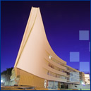
EBN 122: Practical 3
Agenda
Objectives
Description of Operational Amplifiers
Physical Construction on NI Elvis prototyping board
Physical connections of the Operational Amplifier circuit
Practical Preparation

Slide 3
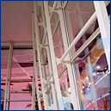
EBN 122: Practical 3
Objectives
The objective of this practical is to build two operational amplifier circuits, and
To record their transfer characteristics
  i.e. Input Voltage versus Output Voltage
  NB: Read about the basic concepts of Inverting and Non-Inverting amplifiers in your textbook
The following components will be provided during the practical
  Two resistors, 1 kΩ and 2.2 kΩ
  LM 741 Operational Amplifier
  Connecting wires
NI Elvis workstation and software will be used
The same guidelines of practical 2 for launching the software and using the workstation should be followed

Slide 4

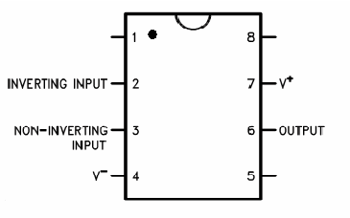
EBN 122: Practical 3
Description of Op-Amps
LM741 Operational Amplifier will be used for this practical, it will be in 8 pin Dual In-Line Package
The physical package layout of the Op-Amp is shown here
The pins correspond to the various inputs and outputs of the Op-Amp
Pin 1 is identified with the dot next to it and all other pins are counted counter-clockwise from pin 1

Slide 5

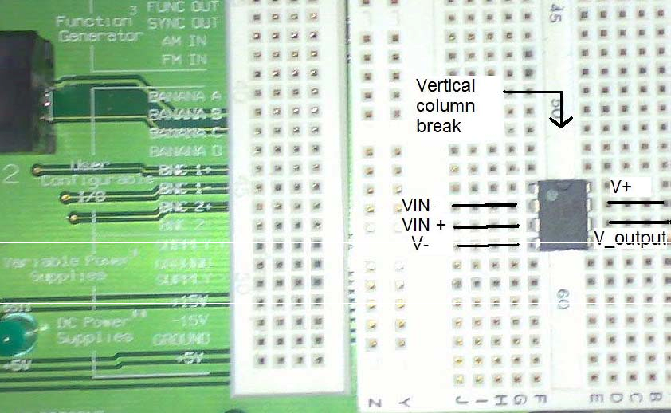
EBN 122: Practical 3
Constructions on NI Elvis
Place the Op-Amp on the prototyping board so that pin 4 and 5 are separated by the vertical column break on the board

Slide 6
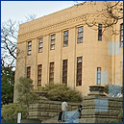
EBN 122: Practical 3
Physical Connections
Connect V+ (pin 7) to the +15 V power supply on the NI workstation
Connect V- (pin 4) to the -15 V power supply on the NI workstation
Connect the input signal to variable power supply (VPS) on the NI workstation
All grounds must be connected to the ground of the NI workstation
Connect resistors according to specific question (1 or 2)
Two circuits will be constructed:
  Inverting Amplifier
  Non-Inverting Amplifier

Slide 7
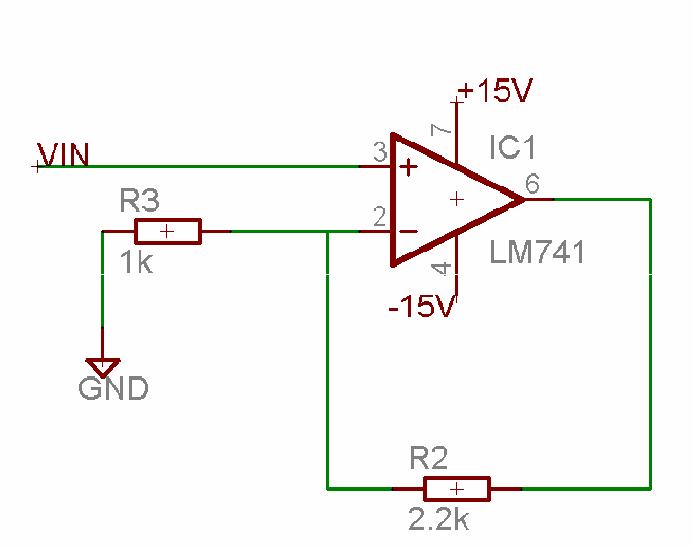
EBN 122: Practical 3
Practical Preparation
Prepare for the practical by using the following questions and figure below:
  Is the output inverted from the input?
  What is the theoretical gain of the amplifier?
  What is the relationship between input and output voltage?

Slide 8
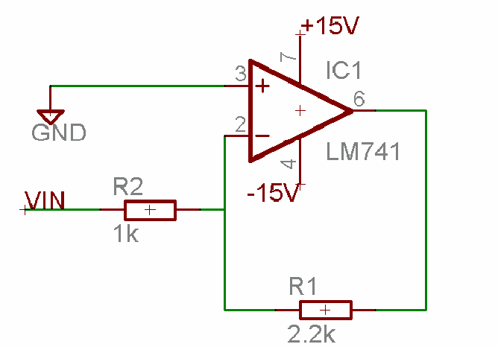
EBN 122: Practical 3
Practical Preparation
Prepare for the practical by using the following questions and figure below:
  Is the output inverted from the input?
  What is the theoretical gain of the amplifier?
  What is the relationship between input and output voltage?

Slide 9
EBN 122: Practical 3
Conclusion
Contact details for Questions or Feedback
  Email: dieter.barnard@up.ac.za
    NB: For all emails use the subject “[EBN122] …”
  Office no.: Eng 1, 13-26
During practical
  There will be two Demis to assist you during the whole duration of the practical
  Ask questions and remember you can also refer to the practical guide or materials available on the module website

